Slide 1

DATA MINING FINAL PROJECT
Movie Success & Revenue Prediction
GROUP MEMBERS: DHARMIK KURLAWALA – 2886995 NITEESH SINGH – 2886321
ADVISOR: DR. SUNNIE CHUNG

Slide 2

Movie Success & Revenue Prediction
Welcome to our data mining project on predicting movie success and revenue. We've developed a machine learning system that can classify films as hits or flops before release and estimate their box office performance.
Our approach combines artificial neural networks(ANN) with gradient boosting to analyze pre-release attributes like budget, cast star power, and genre. This presentation will walk you through our end-to-end process from data collection to deployment.

Slide 3
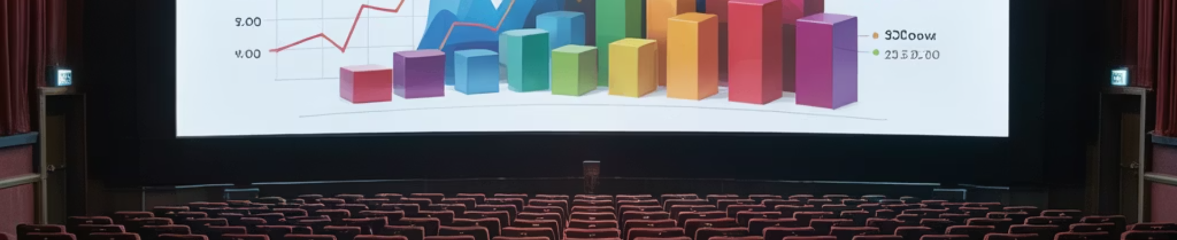



Project Overview
Problem
Objective
Approach
Only a fraction of movies turn profitable. Can we predict a movie's success or flop before release to help studios minimize financial risk?
Use machine learning to classify movies as "Success" vs "Flop" and predict box-office revenue based on pre-release attributes.
Implement an end-to-end ML pipeline from data collection to predicting hit or flop.

Slide 4
Data Collection
Data Sources
Merge Strategy
We utilized two public Kaggle datasets from The Movie Database (TMDb):
Used unique movie ID as primary key to join datasets, enriching each movie entry with cast, director, writers, etc.
Dataset 1: Main movie metadata (title, budget, revenue) for ~10k movies
Result: A single combined dataset with extensive features per movie (TMDB_movie_dataset_Full.csv)
Dataset 2: Additional details (cast, crew, IMDb ratings) for ~1M movies

Slide 5
Dataset Description
Raw Dataset Size: ~10,000 movies (after merging)
Features (Pre-cleaning):
Numeric: Budget, Revenue, Runtime, Popularity, Ratings (TMDb vote_average/count, IMDb rating/votes)
Categorical/Text: Title, Release date, Genres, Languages, Overview (plot summary), Production companies & countries, Cast, Director
Initial Issues: Missing values in some fields (e.g. budget, runtime), some movies with zero runtime or negligible budget
Class Definition:
Defined "Success" as revenue > 1.5× budget (ROI > 150%), otherwise "Flop"
Binary label = 1 (Success) or 0 (Flop) created accordingly
8,835 movies remained after dropping invalid entries (runtime 0, missing budget/revenue)

Slide 6
Data Cleaning & Preprocessing
Filtering
Removed movies with incomplete data (dropped NAs for key fields) and unrealistic values (budget < $1000, revenue ≤ $0)
Label Creation
Created binary label using budget vs. revenue (1 = success, 0 = flop)
Log Transformation
Added log_budget and log_revenue to reduce skew (many movies have low revenue, a few very high)
Train/Test Split
Stratified split (70% train, 30% test) ensuring similar success/flop ratio in each
Scaling
Applied Quantile Transformer to numeric features (budget, runtime, etc.) – maps them to a normal distribution for stable model training

Slide 7
Final Features Selected
1
Star Power Features:
2
Movie Attributes:
3
Text Features:
cast_power, director_power, writers_power, producers_power, production_companies_power, production_countries_power
runtime (movie length), log_budget (log-transformed budget), overview_sentiment (sentiment polarity of the synopsis), release_year, release_month, is_holiday_release (Nov/Dec releases), is_sequel (sequel indicator from title), big_studio (major studio involvement), director_hit_ratio (director's past success rate)
50 TF-IDF features extracted from movie overviews (tfidf_0 to tfidf_49)
4
Genre Features (Multi-hot encoded):
5
Language Features (One-hot encoded):
genre_action, genre_comedy, genre_drama, genre_adventure, etc. (~20 genre features)
lang_english, lang_french, lang_spanish, lang_hindi, etc. (~80+ languages)

Slide 8






Feature Encoding
Text Overview
Extracted TF-IDF features from movie description (50 top terms) to capture text information
Genres & Languages
Multi-label binarization (Multi-hot encoding) for 19 genres and 114 languages (each becomes a binary feature)
Final Feature Set
198 features per movie (after encoding), ready for modeling (stored in movie_features.csv)

Slide 9





Feature Engineering
Star Power
Cast_power, Director_power, Writers_power, Producers_power – Numeric scores assessing the past success of top cast/crew
Director Hit Ratio
Fraction of a director's past films that were successes (e.g., if a director made 10 films and 6 were hits, director_hit_ratio = 0.6)
Movie Indicators
is_sequel (Binary flag if title suggests a sequel), big_studio (if any production company is a major studio), is_holiday_release (1 if released in Nov/Dec)
Sentiment Analysis
overview_sentiment – Sentiment score of the plot summary (range clipped to [-0.5, 0.5]), gauging positive/negative buzz

Slide 10
Feature Comparison
• Result: Our enhanced feature matrix systematically captures critical domain knowledge including star power, director track record, sequel status, and content sentiment. These domain-informed transformations significantly improve model predictive capacity beyond raw data.
Original Feature
Engineered Feature(s)
Description
Cast (list of actors)
cast_power (numeric)
Cumulative influence score of top 3 actors based on their previous box office performance
Director (name)
director_power, director_hit_ratio
Director's commercial influence score; proportion of successful films in their portfolio (0–1)
Title
is_sequel (0/1)
Binary indicator identifying if the title suggests a sequel or franchise installment
Overview (text)
overview_sentiment, tfidf_0...tfidf_49
Emotional tone score of plot summary; Vector of 50 key terms capturing content themes
Genres (list)
genre_* (Multi-hot for each genre)
Binary features for each genre category (e.g., genre_Action=1 if film is Action)
Spoken Languages (list)
lang_* (Multi-hot for each language)
Binary features for each language (e.g., lang_English=1 if English is spoken)

Slide 11
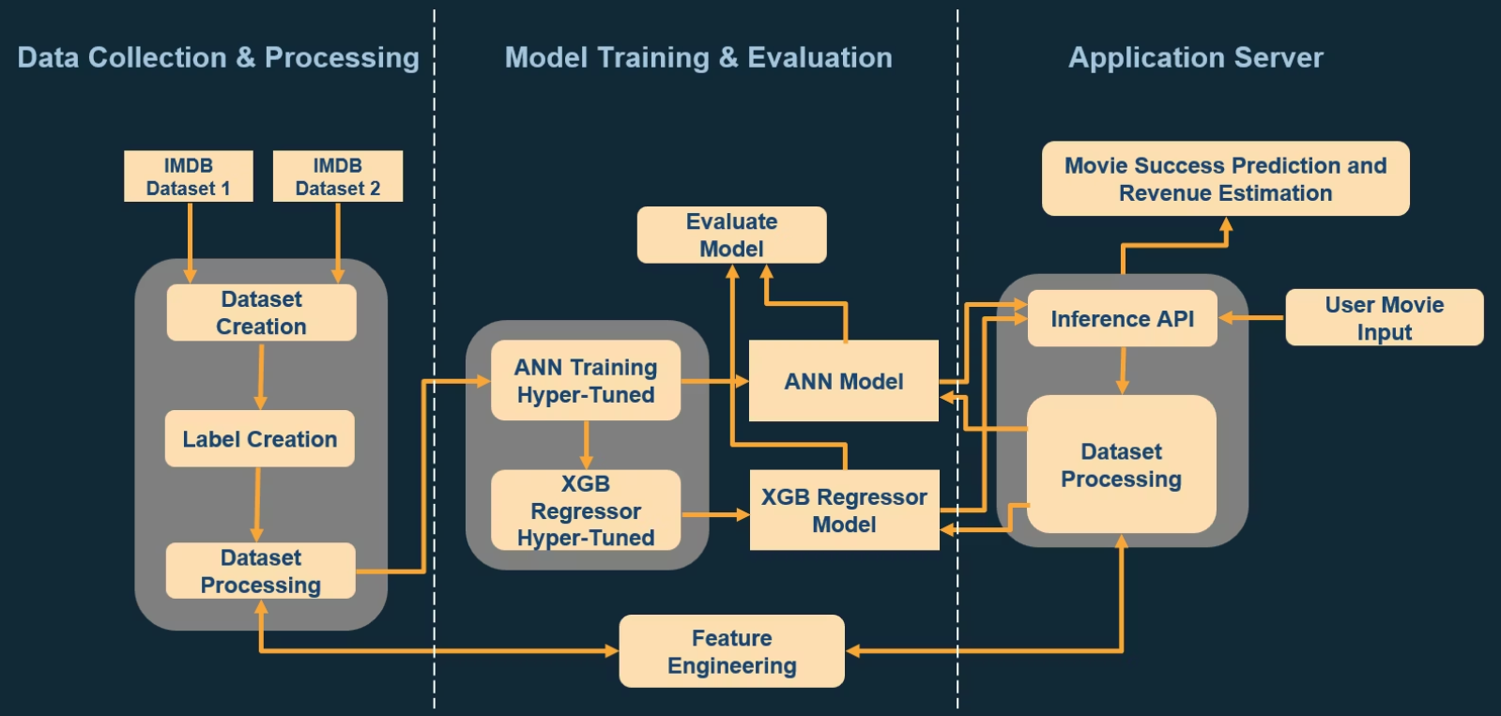
System Architecture

Slide 12
System Architecture
Data Collection & Processing
Model Training
Evaluation
The engineered features are used to train two machine learning models:
The performance of both models is evaluated on a held-out test set:
1
Star Power Features
1
ANN Classifier
1
Classifier Metrics
Scores for the cast, director, writers, producers, production companies, and production countries
A neural network is trained to predict the probability of a movie being a "Success" vs a "Flop".
Accuracy, ROC-AUC, Precision-Recall,
Calibration curve
2
Regressor Metrics
2
Movie Attributes
2
XGBoost Regressor
Mean Absolute Error (MAE) and R-squared (R²)
Runtime, log-transformed budget, sentiment of the synopsis, release year/month, sequel/holiday flags, major studio involvement, director's past success rate
An XGBoost model is trained to predict the log-transformed revenue of a movie, using the engineered features plus the ANN classifier's probability output.
The best-performing model weights and calibration parameters are saved for deployment.
Hyperparameter tuning is performed on the ANN model to find the optimal architecture and training settings.
3
Text Features
50 TF-IDF features extracted from the movie overviews
4
Genre & Language Features
One-hot encoded genre and language indicators

Slide 13
ANN Classifier Model
Output Layer
Hidden Layers
1 neuron with Sigmoid activation
(success probability)
Input Layer
•Layer 1: 128 neurons, ReLU activation, L2 regularization (λ=1e-4)
198 engineered features
•Layer 2: 64 neurons, ReLU + Batch Norm
•Layer 3: 32 neurons, ReLU
Model Training
1
Optimizer & Loss
2
Class Balancing
Trained the ANN classifier using the Adam optimizer and Binary Cross entropy loss function.
Handled the slight class imbalance by applying class weights, ensuring a balanced training focus on both success and flop predictions.
3
Early Stopping
4
Training Details
Monitored the validation loss and stopped training when there was no improvement for 8 epochs, avoiding model overfitting.
Trained the model for up to 60 epochs, with an effective ~20 epochs until convergence. Used a batch size of 64.
The final trained classifier model (cls_model.keras) was saved for evaluation and later use in the deployment pipeline.

Slide 14
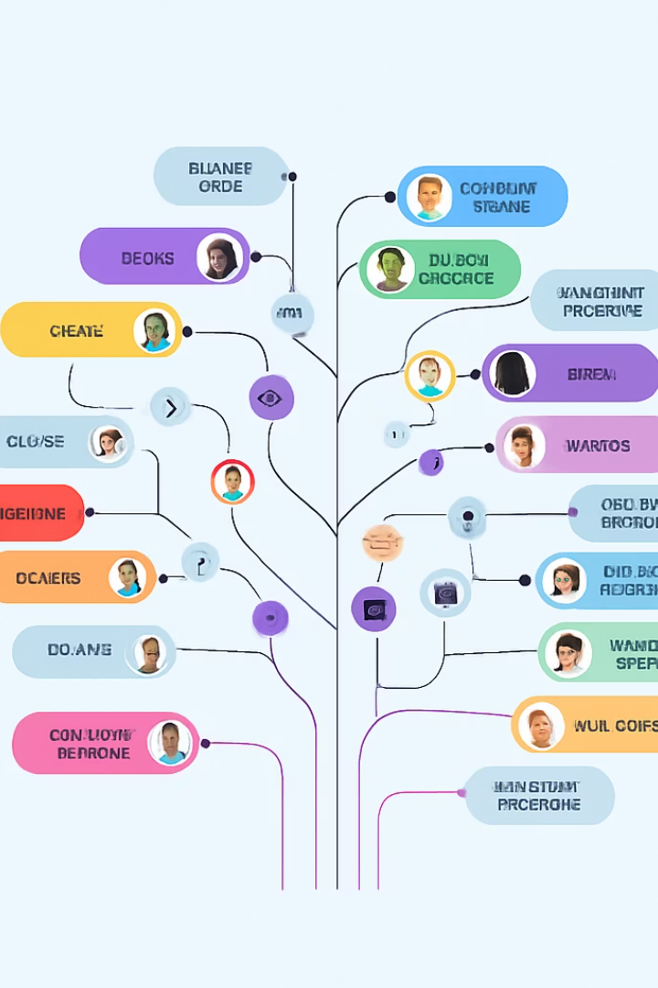




XGBoost Regressor Model
Objective
Predict the log of revenue, enabling direct prediction of box-office receipts in dollars (after exponential transform)
Features
All engineered features plus the ANN's predicted success probability, enriching the regressor's input with an estimate of movie quality
Training Strategy
5-fold Cross-Validation to find optimal parameters: max_depth=6, learning rate eta=0.05, subsample 80%, with early stopping
Regularization
Used tree depth limit and column subsampling to prevent overfitting and ensure good generalization

Slide 15

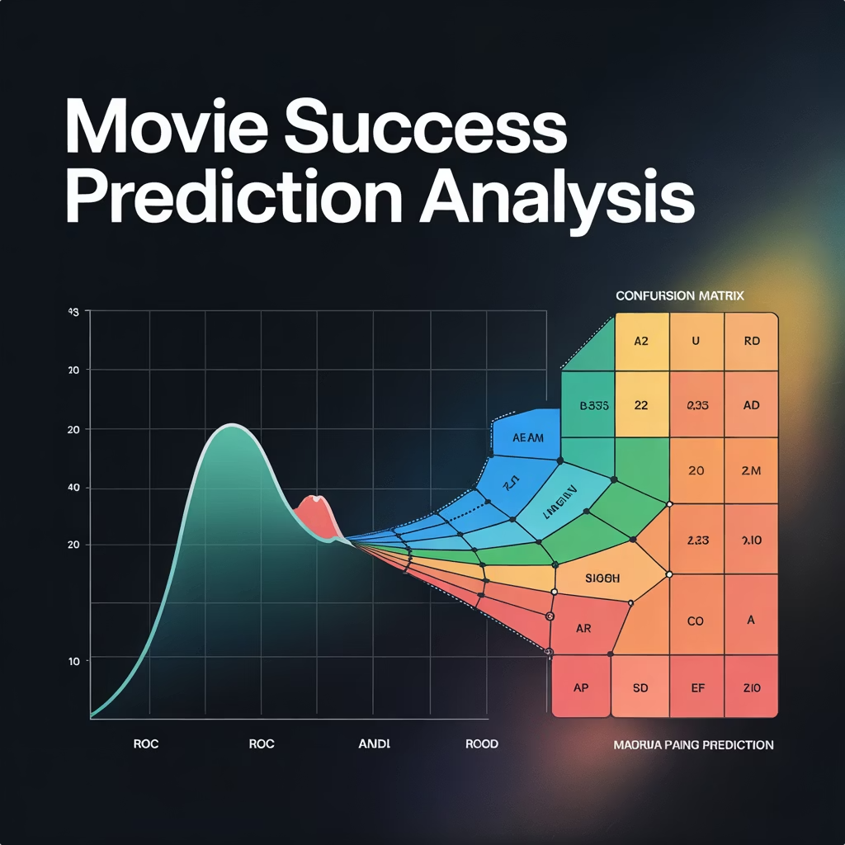
Classification Performance
~84%
Accuracy
Percentage of movies correctly classified as success or flop
0.92
ROC-AUC
Indicates good discrimination between successful and flop movies
~82%
Precision
When model predicts success, it's right about 4/5 of the time
~91%
Recall
Model catches about 9/10 of the actual hits

Slide 16

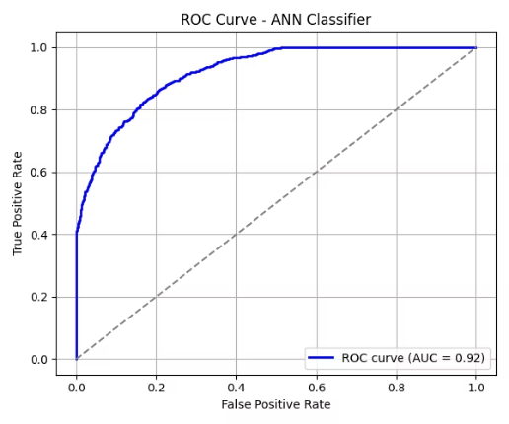
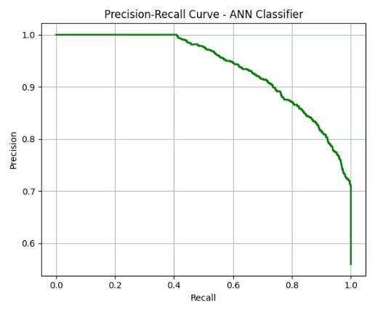
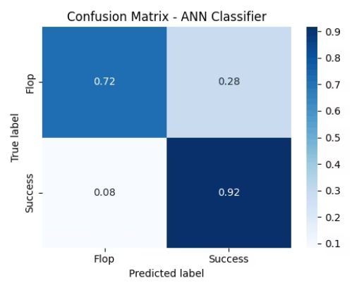
Evaluation Plots

Slide 17
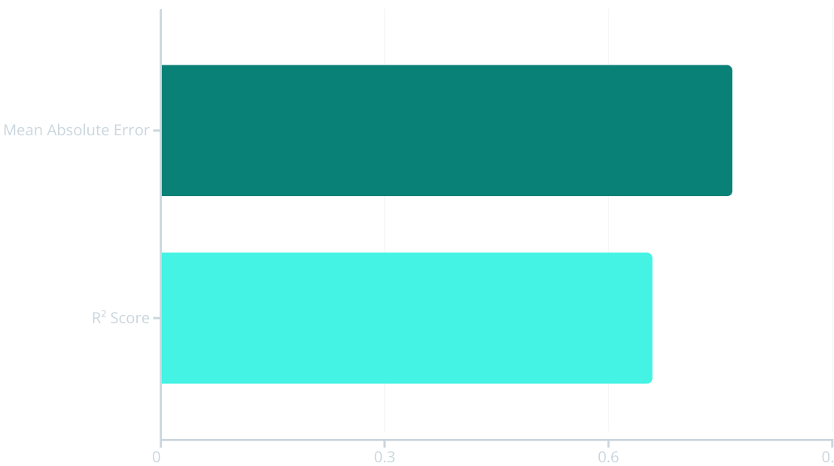
Revenue Prediction Performance
Our XGBoost regressor achieves a Mean Absolute Error of approximately $33 million in revenue predictions. Considering some blockbusters earn hundreds of millions, this error is reasonably low.
The R² Score of ~0.66 indicates the model explains about 66% of the variance in movie revenues. While not perfect, this provides significant predictive power, especially for an industry with inherent unpredictability.

Slide 18




Challenges Encountered & Solutions
Data Quality Issues
Distribution Skew
Encountered incomplete values for budget and runtime. Applied strict data cleaning filters and statistical imputation techniques to ensure dataset integrity.
Blockbuster outliers created extreme revenue imbalance. Implemented log transformation and leveraged XGBoost's inherent ability to handle skewed distributions.
High Dimensionality
Model Optimization
Feature explosion (~200 features) after encoding. Combined regularization techniques with models designed to handle high-dimensional spaces.
Addressed class imbalance with stratified sampling and implemented careful pipeline separation to prevent data leakage between stages.

Slide 19
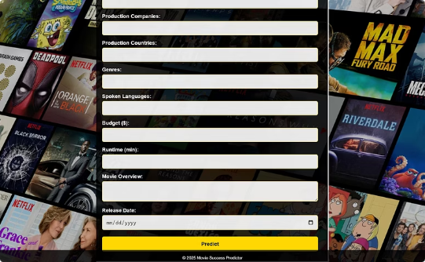
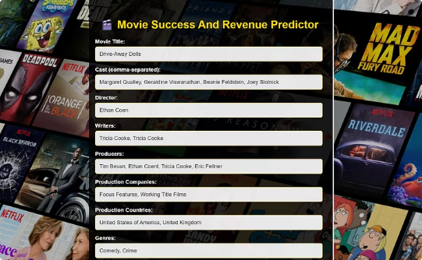
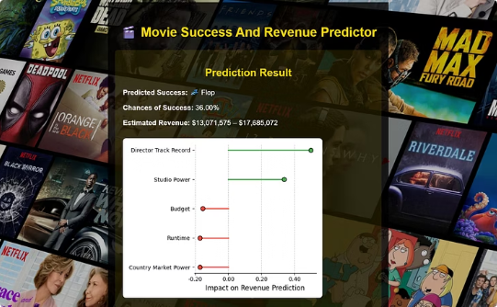
Deployment
User Interface
Flask Web Application
Prediction Results
A simple web form with fields for key inputs (cast, director, budget, etc.) that allows users to enter information about upcoming movies.
RESTful API using Flask that processes user input, computes features, and calls models to generate predictions.
The application returns success probability and estimated box office revenue to help inform production decisions.

Slide 20




Conclusion & Future Work
Project Outcome
Developed a working ML system that can predict with decent accuracy whether a movie will be
a hit or flop, and estimate its revenue before release.
Impact
Such a model could serve as a preliminary "greenlighting" tool for studios – supporting budgeting decisions and marketing strategies by identifying high-risk projects early.
Future Work
Incorporate social media hype, genre trends, and actor popularity indices. Experiment with advanced models and keep the system updated with recent data as the film industry evolves.

